Slide 1

MSA 8200 Predictive Analytics Final Project Spring 2022
Zillow Housing Data Analysis

Slide 2
Shreyashi Mukhopadhyay Shalmali Joshi Namit Srivastava Nhi Nguyen
Analysis

Slide 3
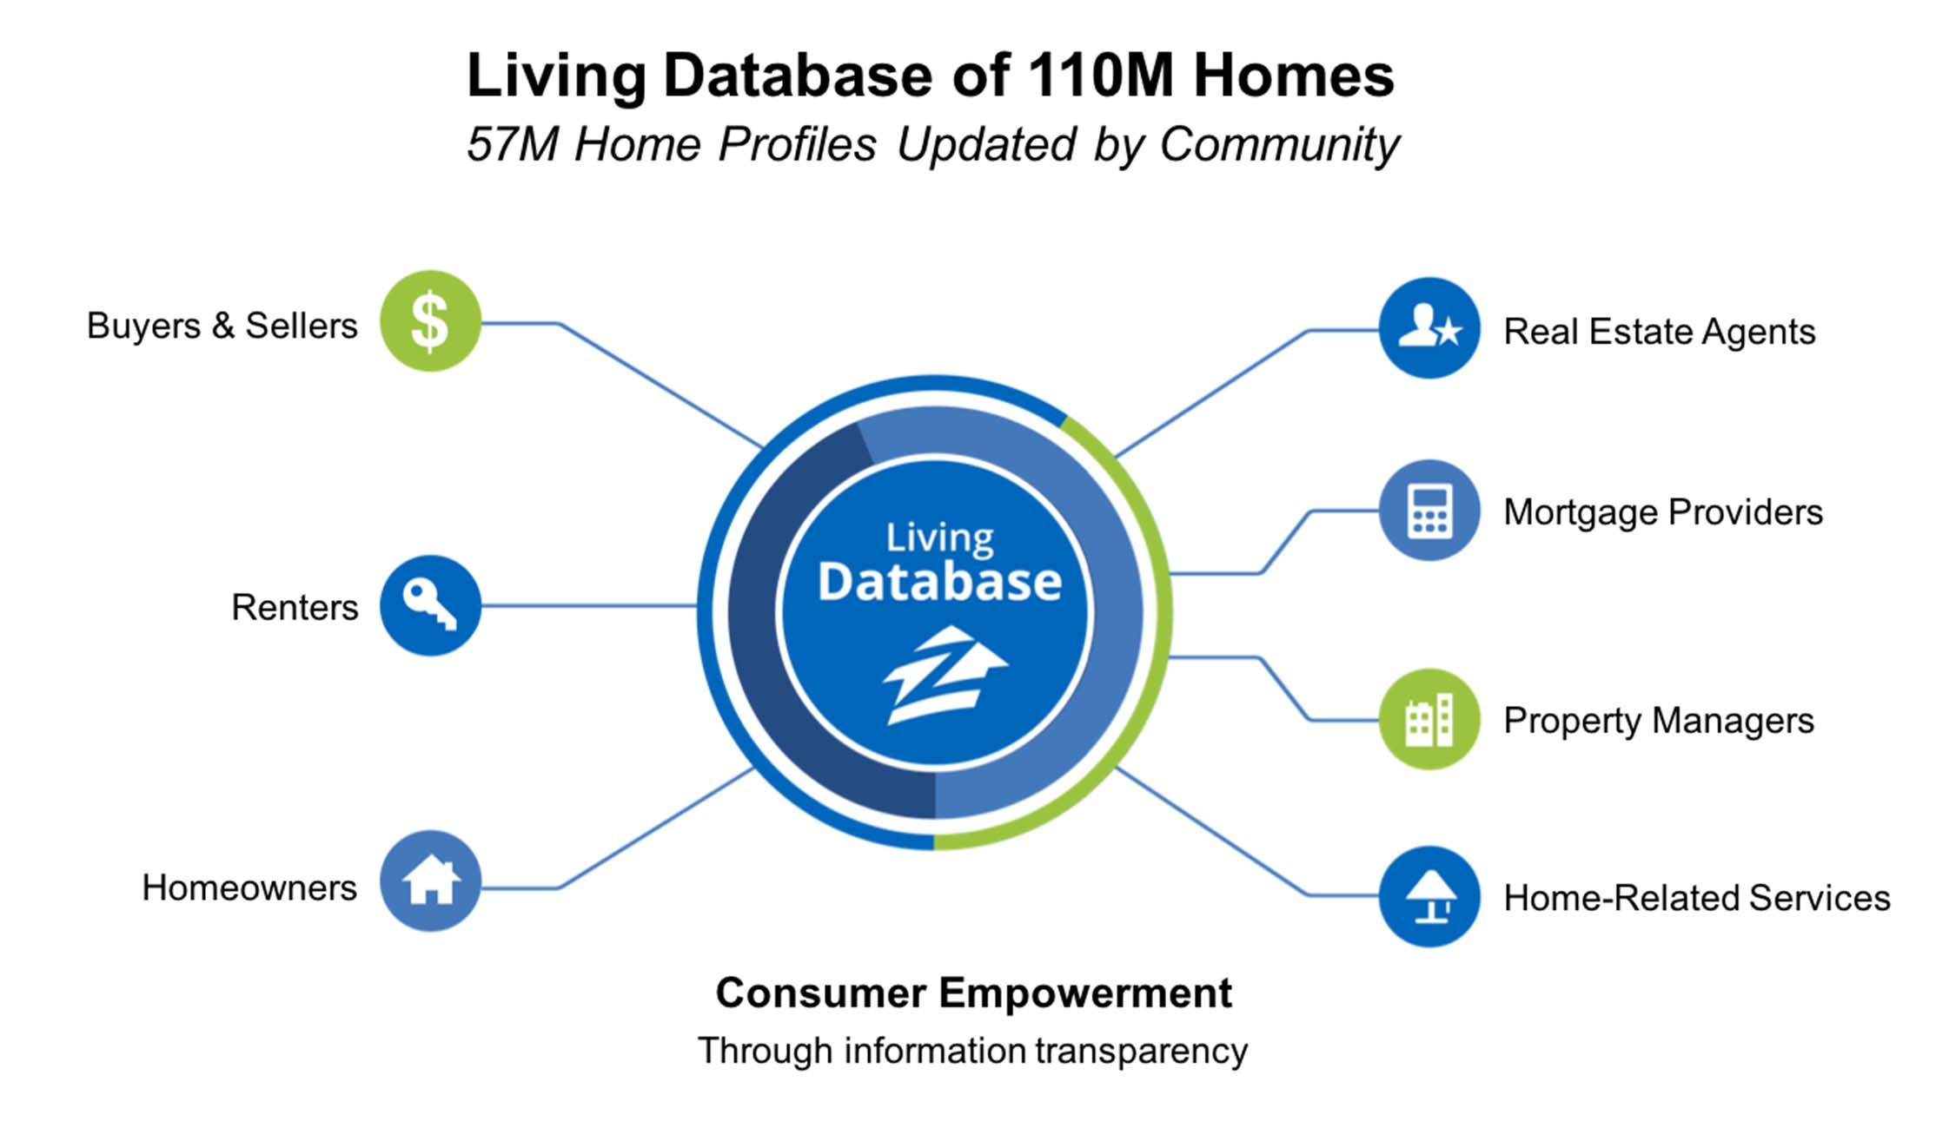
Introduction

Slide 4
Project Description
Zillow.com is the most popular online real-estate website and mobile app in the United States and it provides updated home information to tens of millions of buyers and sellers, Real Estate Agents and Financial Institutions among other affiliates every day.
Our goal is to analyze the Zillow Economics Data and identify the patterns in the housing market especially highlighting the most expensive and the least expensive housing markets in the US.
This project encompasses a complete analysis of data through data visualization, data exploration, pattern discovery and time series modelling in R as the programming language.

Slide 5


Data source
The data has been sourced from the Zillow Economic dataset on Kaggle.com at https://www.kaggle.com/datasets/zillow/zecon?select=State_time_series.csv
Additional Research data: https://www.zillow.com/research/data/
We have used the State_time_series.csv dataset for our analysis.
This dataset has been constructed with housing data from 1996 up until the last update to this data in 2017. The dataset has been created by compiling and organizing public data and Zillow's own proprietary data.
The dataset contains : 13212 obs. of 82 variables.

Slide 6
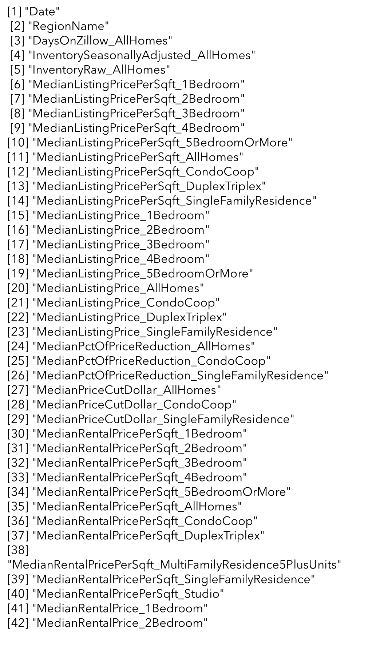
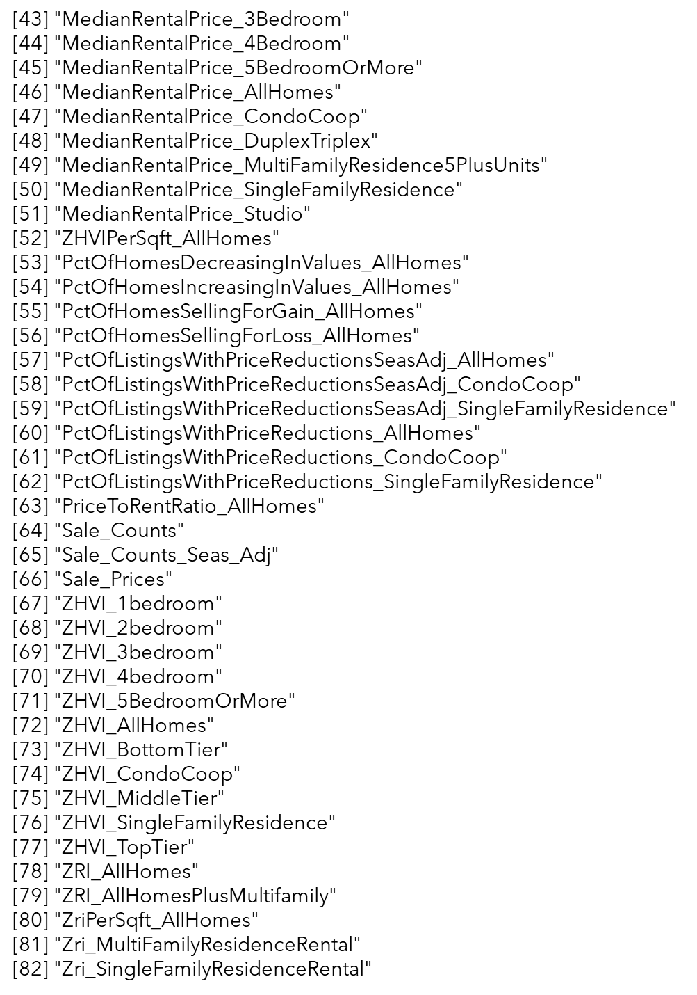
Data description

Slide 7

Zillow Metrics
Zillow Home Value Index ZHVI Measures monthly changes in Zestimates, captures both the level and appreciation of home values across a wide variety of geographies and housing types.
Housing type definitions: Zillow classifies Homes with a county record as:
Studios
Condos
1-Bedroom
2-Bedroom
3- Bedroom
4- Bedroom
5 or more Bedroom
Single-family Home
Multi-family Home
Duplex/Triplex
Zillow Rent Index ZRI: Adjusted measure of the median rent across a region and house type.
Rent Listing Metrics: Median rents and prices for homes based on region and type and bedroom count
Inventory Metrics: On-site data from Zillow which includes list prices, inventory, price cuts, and how long a post remained on Zillow before sale.
Homes Listing Metric: Median Listing prices for Data on the sell price of homes based on housing type.
Tiers: By Metro, Zillow determines the price tier cutoffs that divide all homes into thirds using the full distribution of estimated home values. The resultant categories defined by these cutoffs as Bottom, Middle, and Top Tiers.

Slide 8
EDA and Data Visualization
Shreyashi Mukhopadhyay

Slide 9
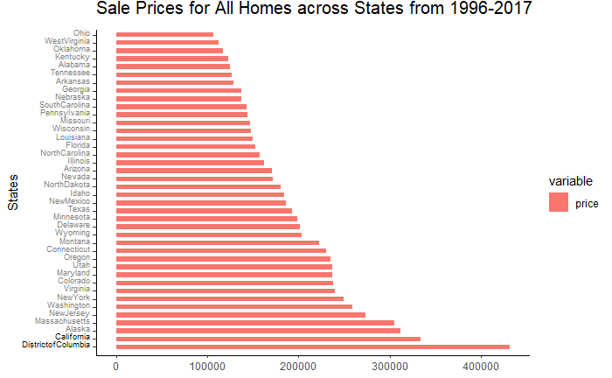
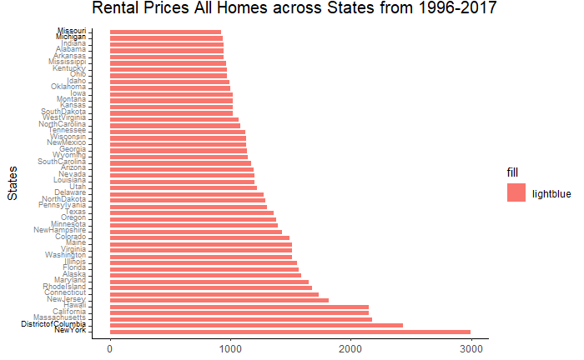
Sale price and Rental price for All Homes

Slide 10
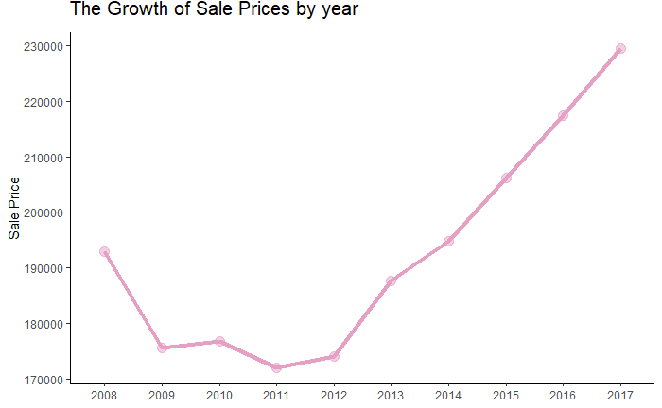
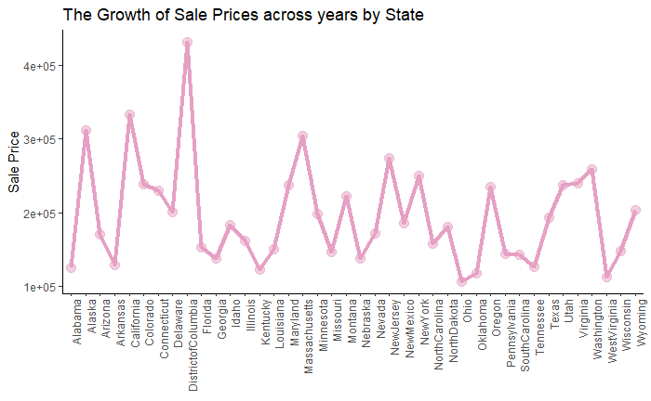
Growth in the Sale Prices across Years and State

Slide 11
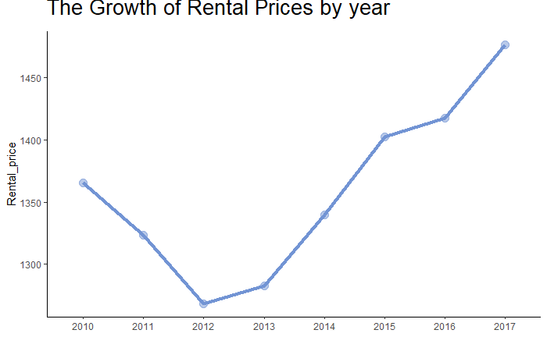
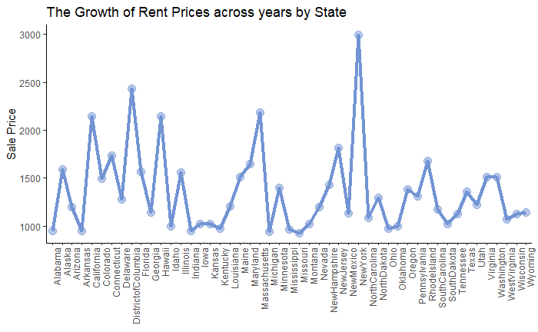
Growth in the Rental price across years and states

Slide 12
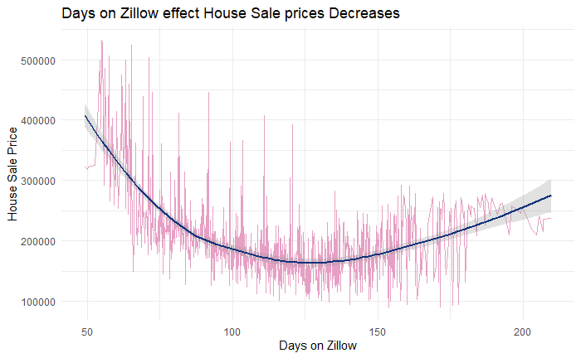
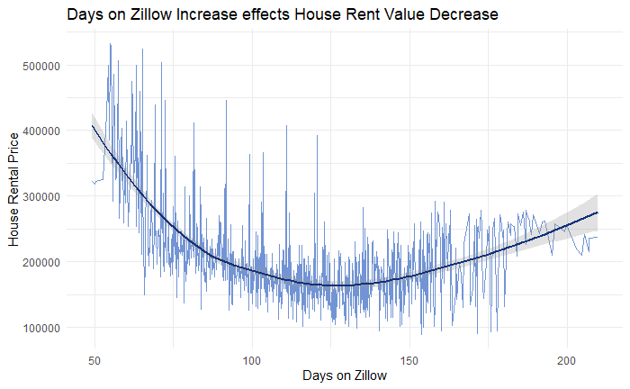
Days on Zillow effect on sale price and rent price

Slide 13
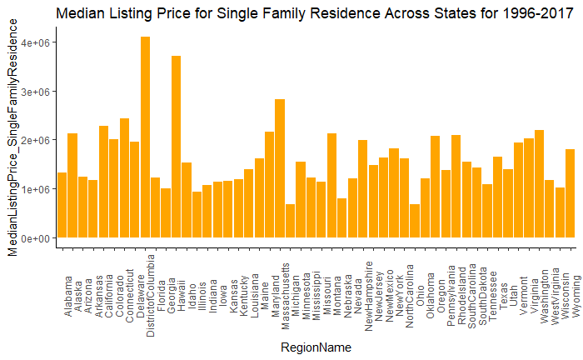
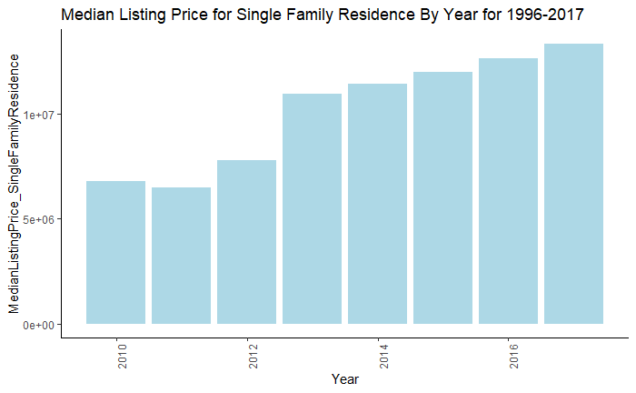
Median Listing price for Single Family Home across years in US

Slide 14
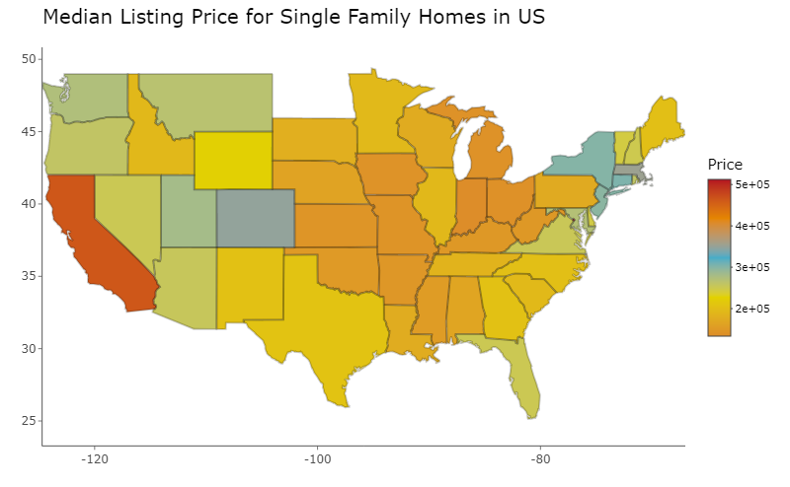
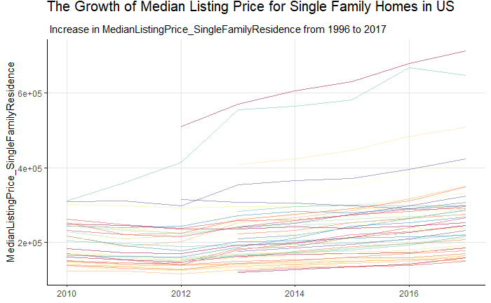
Median Listing price for Single Family Home across years in US

Slide 15
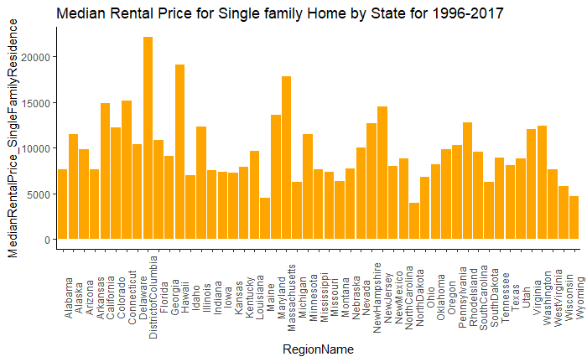
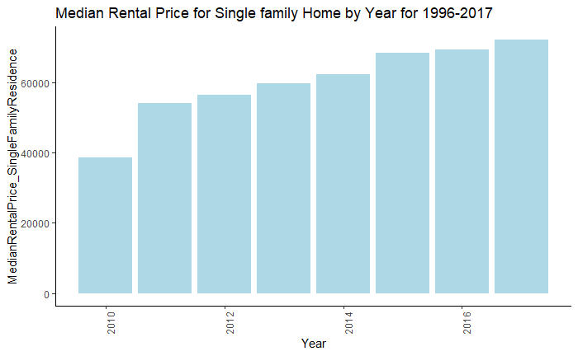
Median Rental price for Single Family Home across states and years

Slide 16
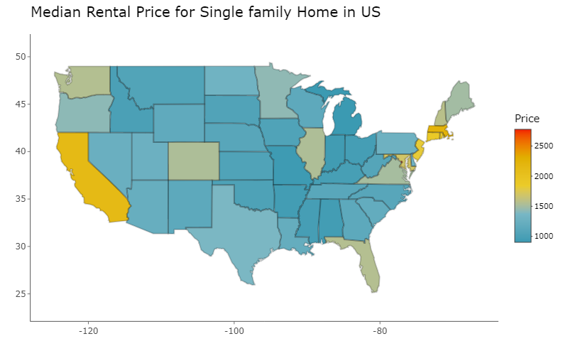
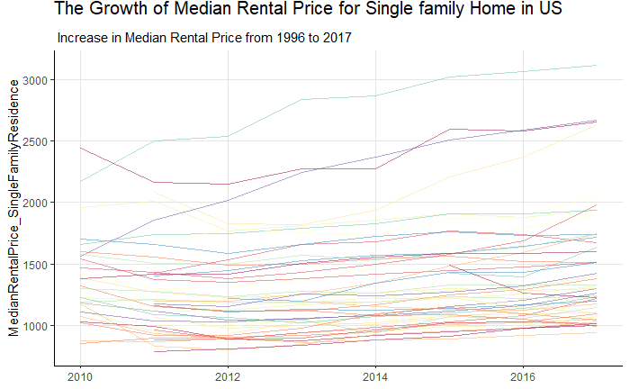
Median Rental price for Single Family Home across states and years

Slide 17
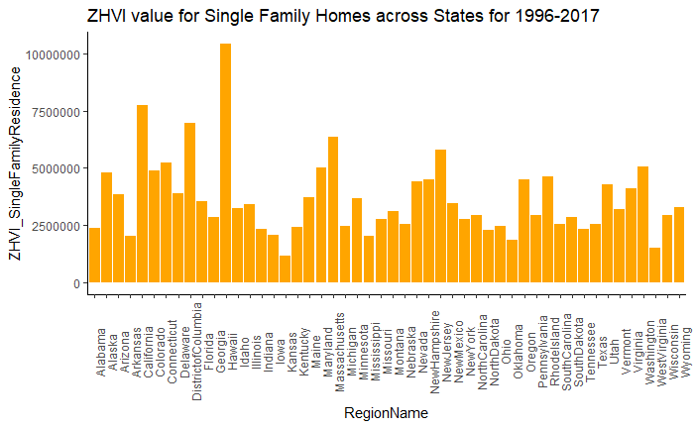
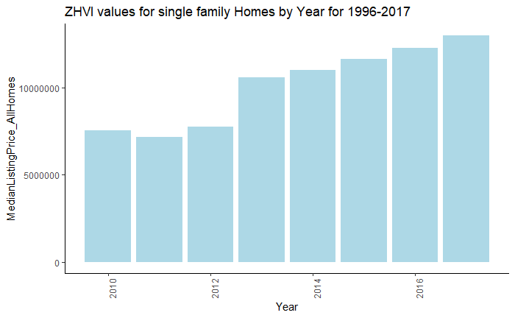
ZHVI values for Single Family Home across states and years

Slide 18
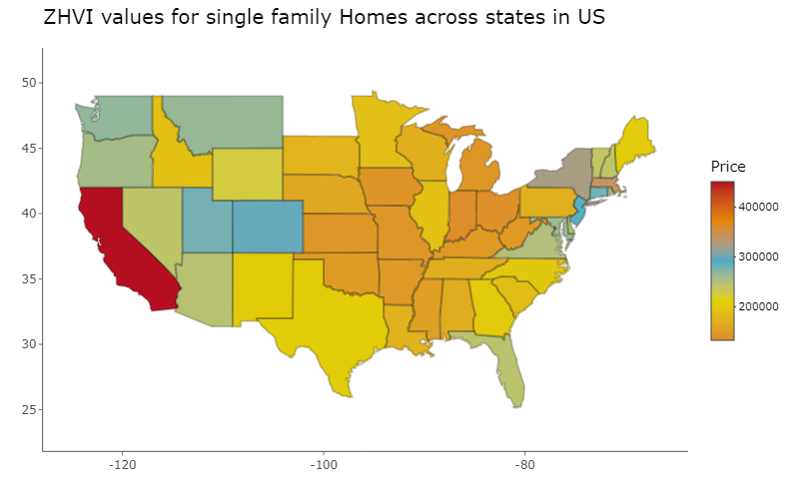
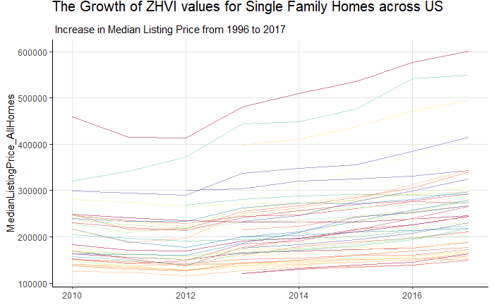
ZHVI values for Single Family Home across states and years

Slide 19
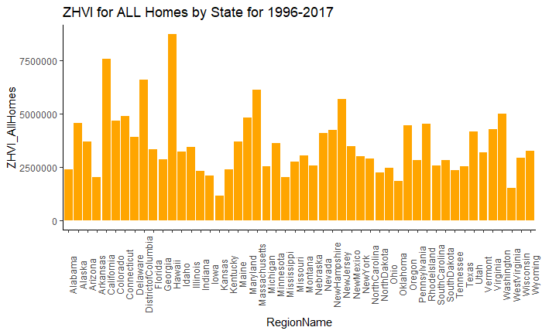
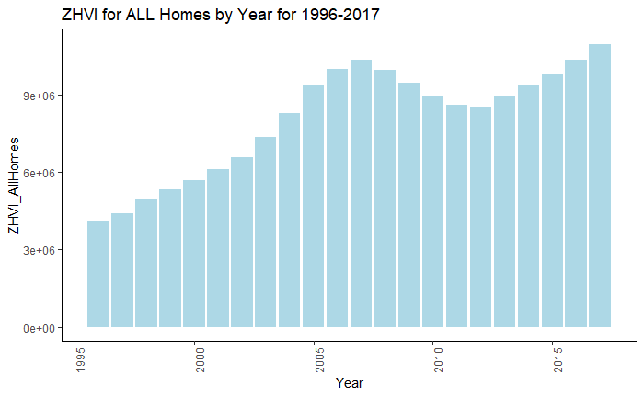
ZHVI values for All Homes across states and years

Slide 20
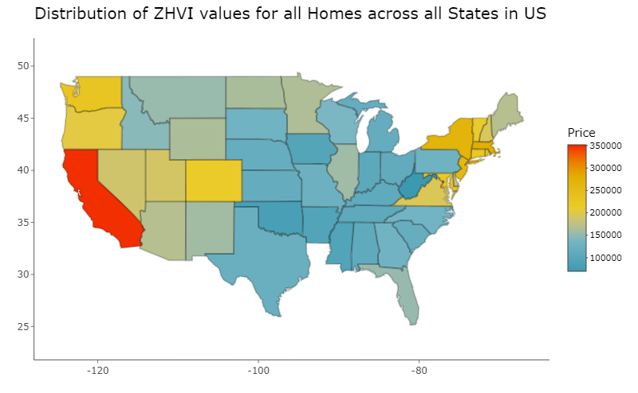
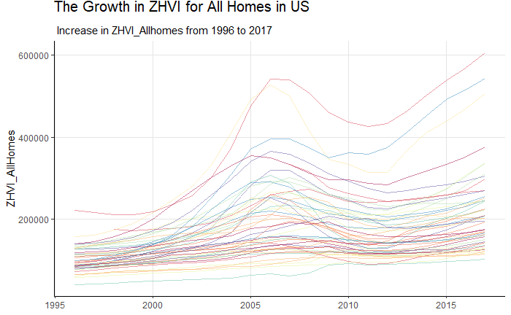
ZHVI values for All Homes across states and years

Slide 21
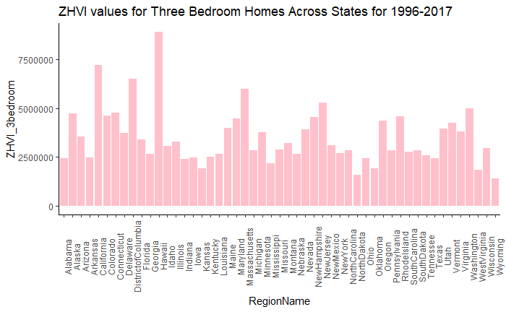
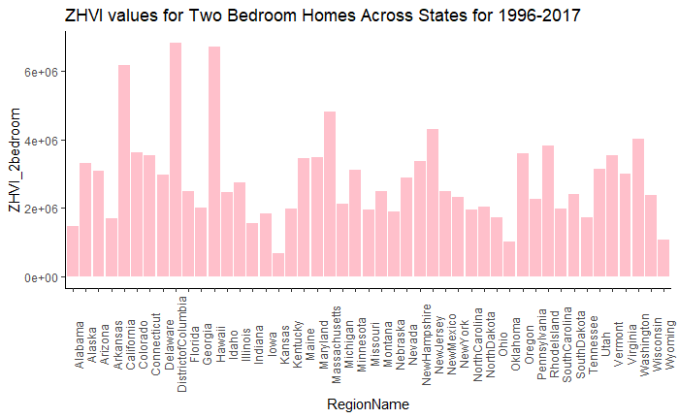
ZHVI values of 2 Bedroom and 3 Bedroom Homes across years in US

Slide 22
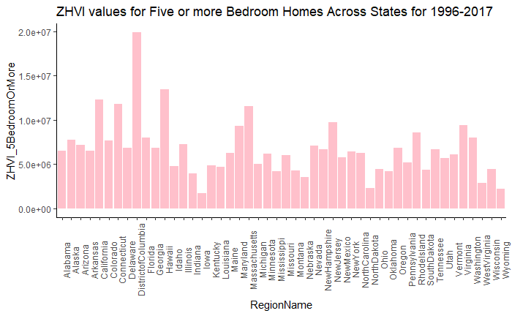
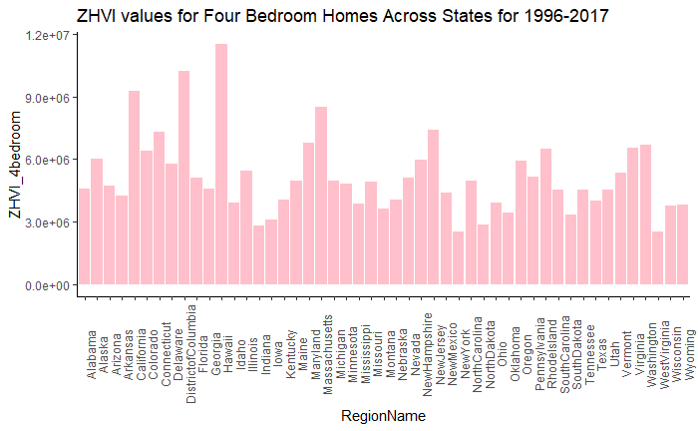
ZHVI values of 4 Bedroom and 5 Bedroom Homes across years in US

Slide 23
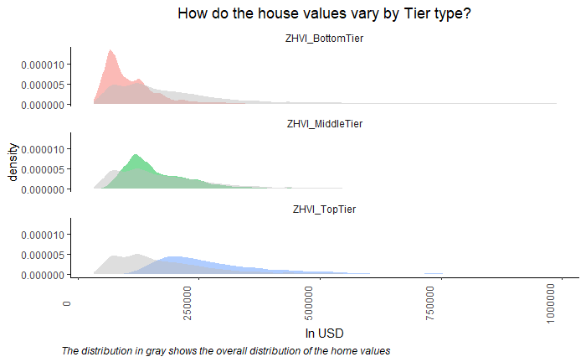
Tier wise classification of All Homes across years in US

Slide 24
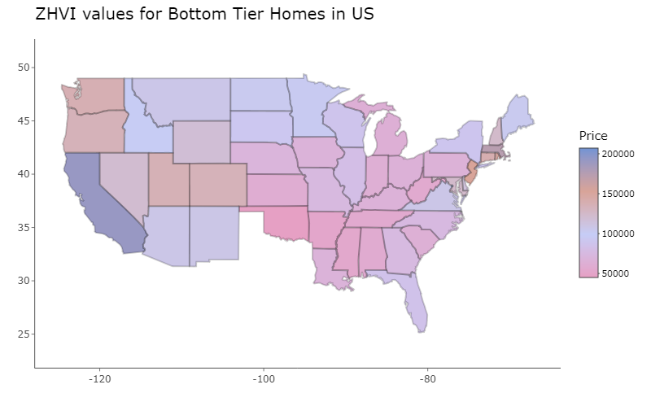
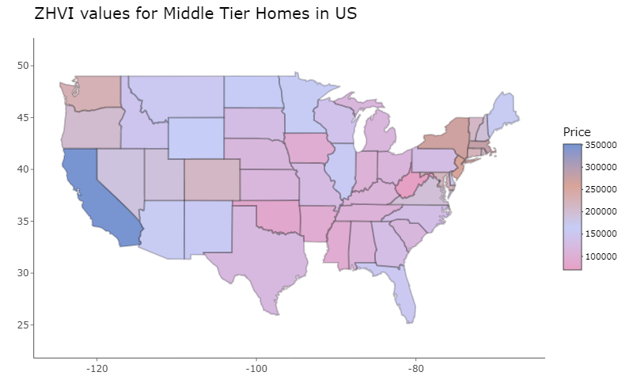
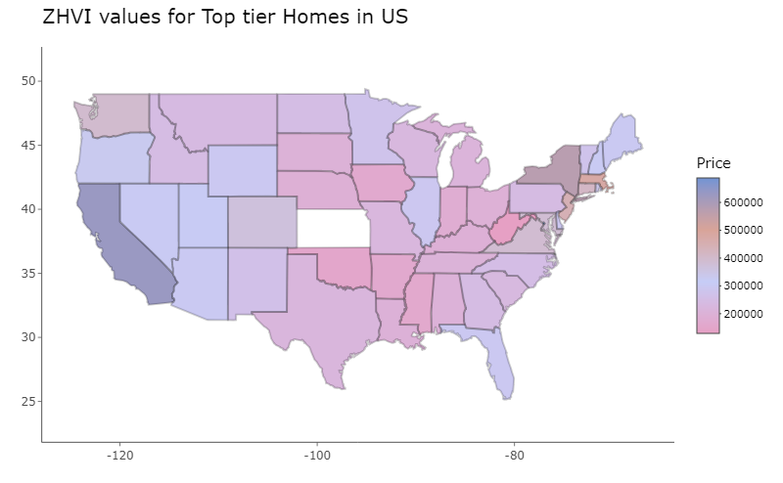
Tier wise distribution of All Homes across years in US

Slide 25
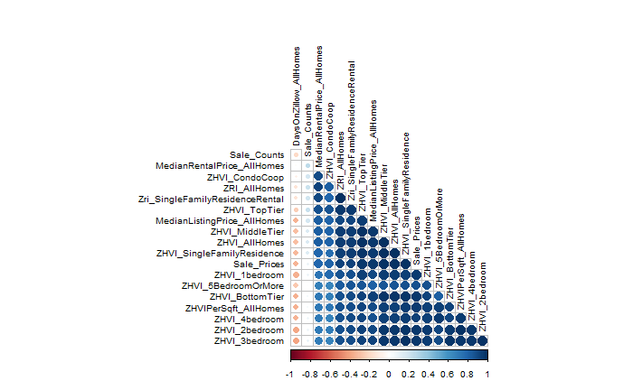
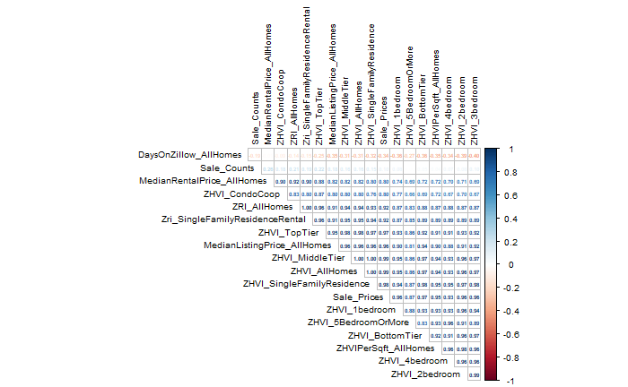
Correlation matrix between metrics

Slide 26
Inference from Data Visualizations
District of Columbia, California, Alaska, New Jersey, Massachusetts are the most expensive states for buying a Home.
New york, District of Columbia, Massachusetts, California and Hawaii are the most expensive states for renting a Home.
California, Hawaii and District of Columbia have the highest ZHVI values for 2 Bedroom, 3 Bedroom, 4 Bedroom and 5 or more Bedroom homes.
The Low, Mid and Top tier homes are most expensive in California.
The larger the days the house is on the Zillow database, the lower its value.
The south and central regions of US have more affordable property prices.
There is a strong positive correlation between the sale prices and the zillow metrics.

Slide 27
EDA, Pattern Discovery, Timeseries Modelling and Sales Forecasting
Shalmali Joshi

Slide 28
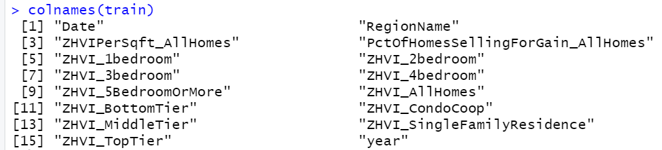
Data cleaning and EDA
Removed all unnecessary columns to focus on research for ZHVI All Homes, 1-5 Bedroom Homes, Condos and Top, Middle Bottom Tier Homes
Removed all NA Values and took subset of dataset to focus on following attributes for my further analysis:

Slide 29
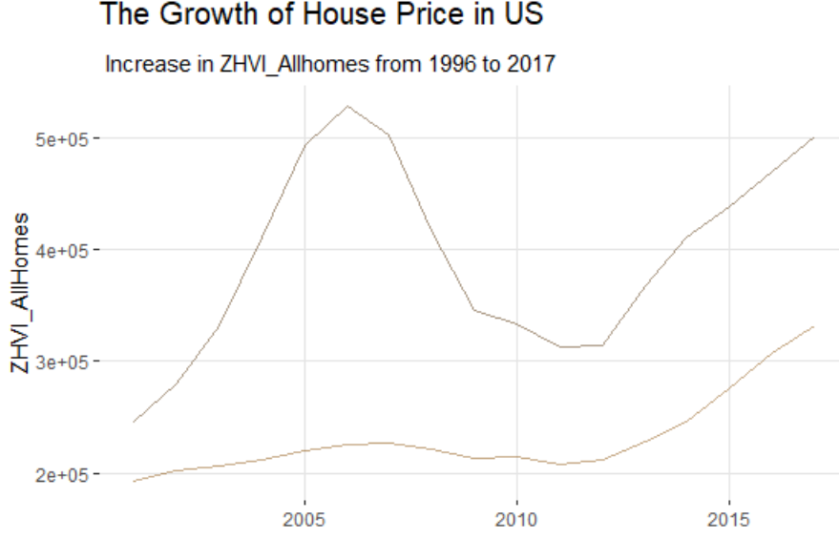
House Price changes in the US (1996-2017) based on Region

Slide 30
Observations:
a) Real estate market was at its peak in 2005: found multiple reasons like reinstated IT stability, global trade and political stability.
b) It crashed miserably in 2008 and continued to remain low till 2011 due to world-wide recession, financial crisis due to oil and bankruptcy of major banks like Lehman Brothers
c) There was a revival in real estate market post 2012 when it again started going upwards onto 2017

Slide 31
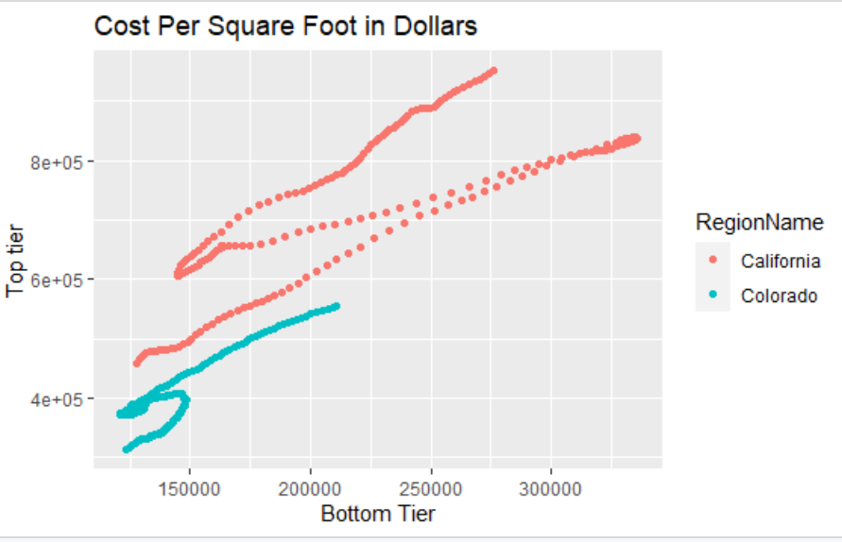
Bottom Tier vs Top Tier Real estate Prices Distribution
Across all years, Top tier Real estate market has been in California while Colorado prices make up the bottom tier.

Slide 32
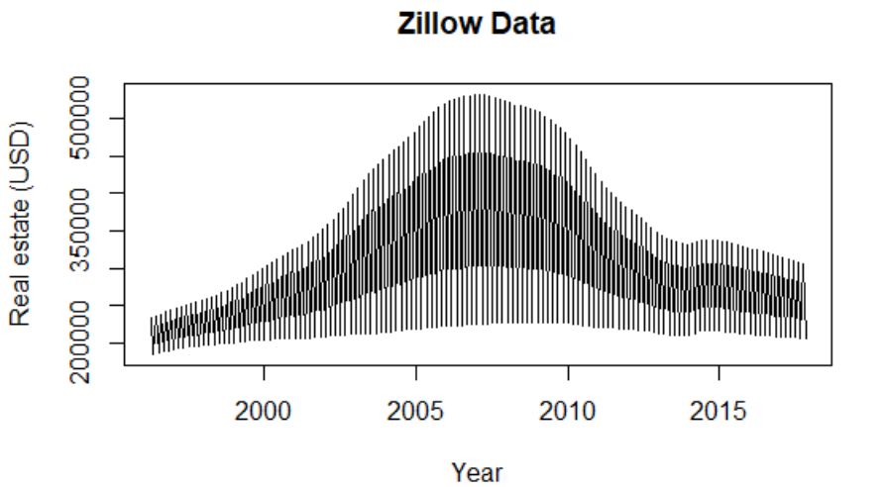
US All Homes Sales aggregate time series
Time series shows trend. It is not stationary and we need to decompose it.

Slide 33
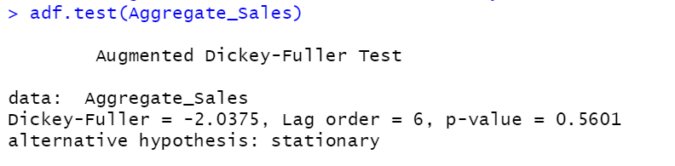
Augmented test
We got high p-value = 0.5601 hence we fail to reject the Null Hypothesis that the time series is stationary

Slide 34
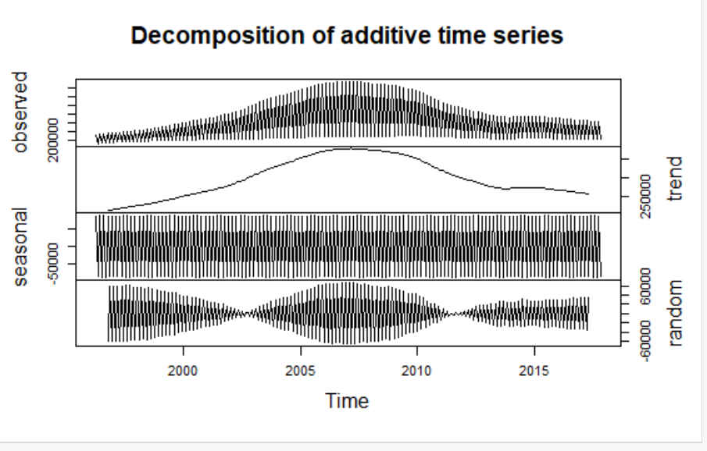
US All Homes Sales Decomposition
There is definite trend in data but indefinite seasonality - Peaks in the end of the year and small peaks in the summer months.
The trend in home prices was at highest in 2005, decreased rapidly from 2008 to 2011 and increased again from 2014 to 2017.

Slide 35
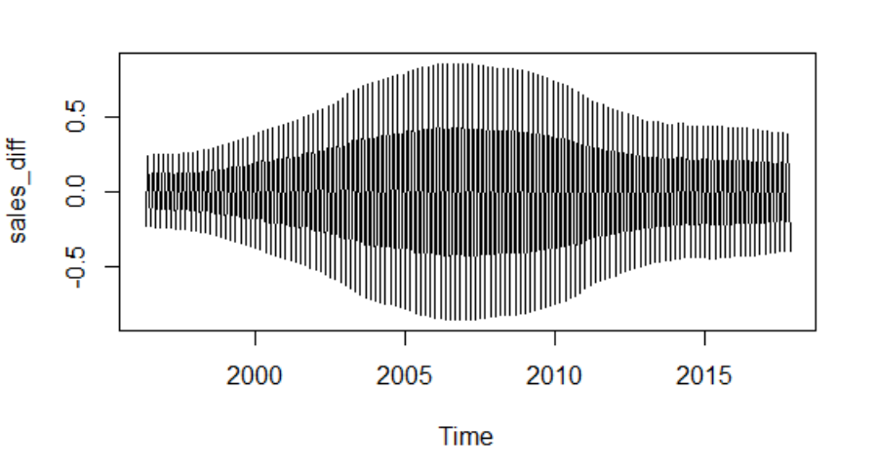
US All Homes Sales Transformation
With log and difference transformations, we are successful in making time series stationary

Slide 36
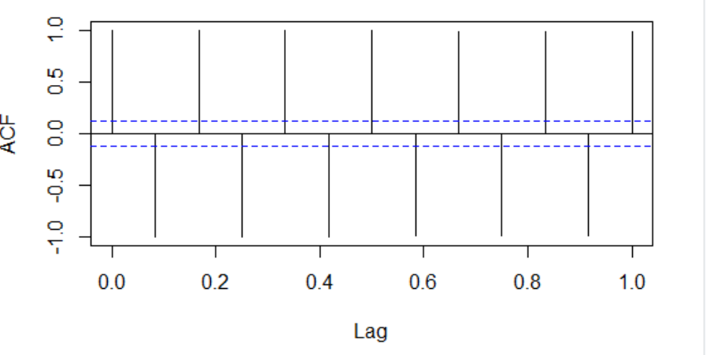
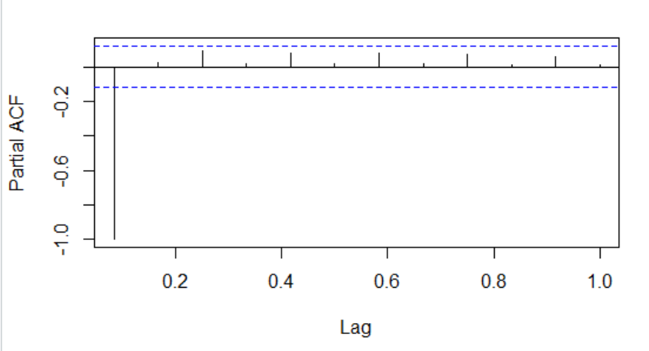
ACF and PACF
As per the ACF plot, it seems to be an AR(1) model. PACF spikes at 0 position, indicating an MA(0) model
Further the seasonal pattern is 12 months.

Slide 37
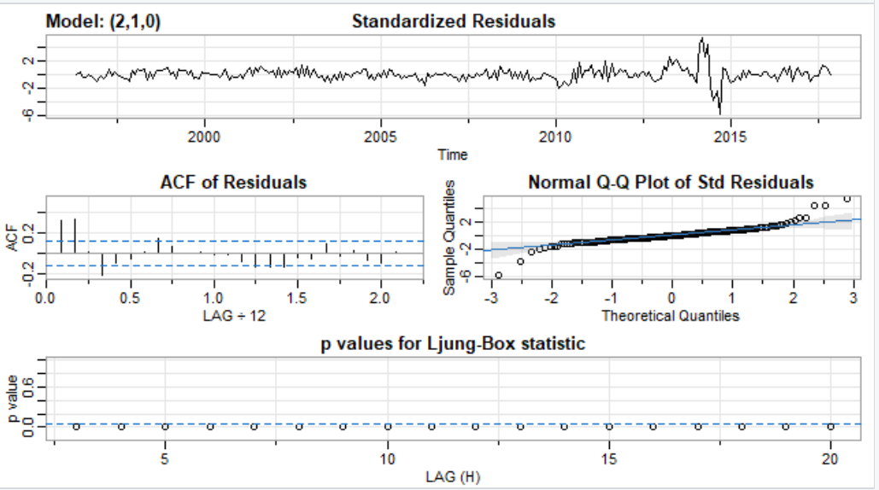
Sarima model (with additional variables)

Slide 38
Observations:
a. The Standardized residuals show some pattern until end of 2005 where the real estate sales are highest. They again decrease at start of 2011 and then remain constant. Since there is no continuous pattern, it resembles white noise.
b. Similarly, ACF also resembles the Standardized Residuals in terms of white noise.
c. QQ plot has few outliers in the beginning but otherwise has a good fit
d. The P-values are all below the significance level which again suggests white noise.

Slide 39
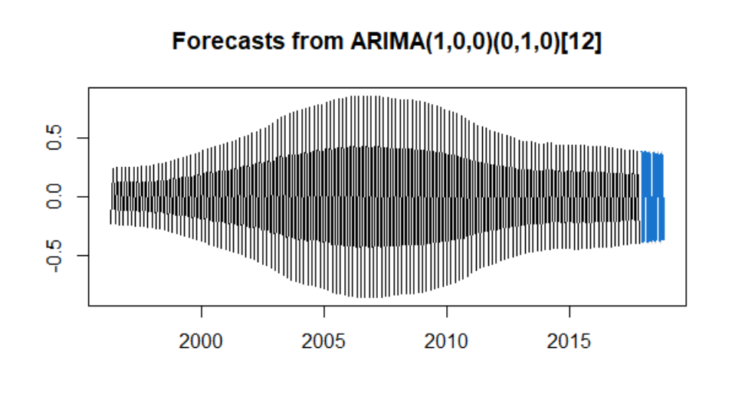
Yearly Sales Forecast
Suggests continuous pattern in Real Estate Home Sales after 2017. It means demand for houses will keep on booming.

Slide 40
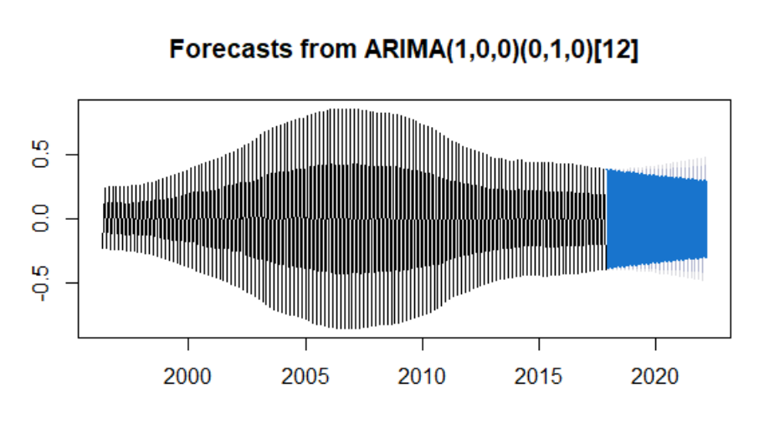
Monthly Sales Forecast
In sync with yearly forecast for future trend indicating demand for houses.

Slide 41
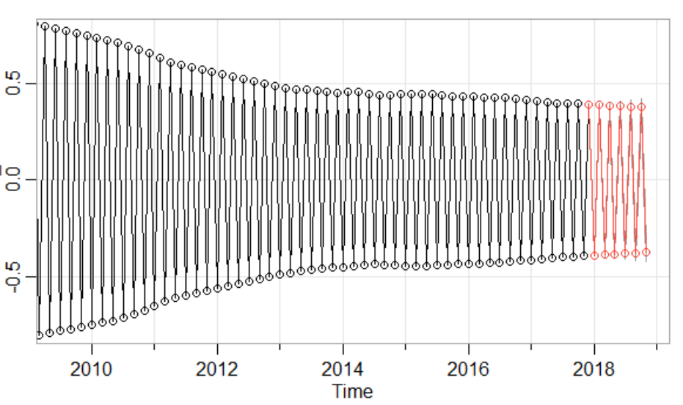
SARIMA Sales Forecast

Slide 42
Advanced Modelling with Additional variables
Namit Srivastava

Slide 43
Regression Models Based Projections
Key Takeaways from EDA for Building The Model
The Sale Price of the homes vary significantly by Region for obvious reasons. So, need to build separate model for each region
For each Tier prediction, the model must be built separately. We can predict the direction of the tiers from each other but not the actual price by tier
The sales price is Bi-modal, with no consistent seasonality and the change in Trends driven most likely by external factors
To explore opportunity to find other data to predict sales, especially the upward and downward trend, employment rates (from Labor statistics website) and Interest rates were also compared
Based on the above Linear Regression was used to fit and predict the trend

Slide 44



State Wise Trends
The time series heavily depended on preceding values
The available variables were not strong predictors to change in trends
Different Regions have change in trends(bends) around same time (as we would expect) but the magnitude was different

Slide 45

External Factors
The available variables were not able to predict the change in trends
Different Regions have change in trends(bends) around same time (as we would expect) but the magnitude was different
Unemployment Trends change correlates to significant change seen in Sales Trends

Slide 46

External Factors
The available variables were not able to predict the change in trends
Different Regions have change in trends(bends) around same time (as we would expect) but the magnitude was different
Interest Rate Trends is not strong predictor in this case

Slide 47

Can other variables predict the change in Trend?
The bends can be predicated with the bends in Un-employment rates few months earlier

Slide 48



Georgia
Georgia (ZHVI_BottomTier)
Georgia (ZHVI_Middle Tier)
Georgia (ZHVI_Top Tier)
Variables Used: "Date" "RegionName" "ZHVIPerSqft_AllHomes" "ZHVI_1bedroom" "ZHVI_2bedroom" "ZHVI_3bedroom" "ZHVI_4bedroom" "ZHVI_5BedroomOrMore" "ZHVI_AllHomes" "ZHVI_CondoCoop" "ZHVI_MiddleTier" "ZHVI_SingleFamilyResidence" "ZHVI_TopTier"

Slide 49



New York
New York (ZHVI_BottomTier)
Unemployment Rate
Variables Used: "Date" "RegionName" "ZHVI_2bedroom" "ZHVI_3bedroom"
["ZHVI_5BedroomOrMore" Data Is modal

Slide 50
Summary of Results
The linear model seems to be overfitting
The adjusted R squared values are 98%-99%
The preceding values are strong indicators of future predictions
If possible, we need to find external factors (variables) which can help project the change in Trends

Slide 51
Advanced Modelling with Prophet & BSTS
Nhi Nguyen

Slide 52

Prophet Model
MSPE = 31.05545

Slide 53

BSTS Model - Trend
MSPE = 3.212157

Slide 54

BSTS Model - Seasonality
MSPE = 3.436987

Slide 55

BSTS Model - Trend & Seasonality
MSPE = 3.693665

Slide 56
Conclusion
In this project where trends are not seasonal, the standard methodologies and model do a good prediction in the scenarios both pre and post a significant event (events which changes the Trend) but cannot model the significant events
The variables available are not sufficient to model the significant events
Need to look at alternate data sources or fields to model the change in price. We can also look at Yield curve, availability and price trends of raw materials etc. to predict the overall trends
The linear model seems to be overfitting. BSTS model does a better prediction along with Time series analysis (post significant event trends)
The preceding values are strong indicators of future predictions

Slide 57

Thank you!

